Slide 1
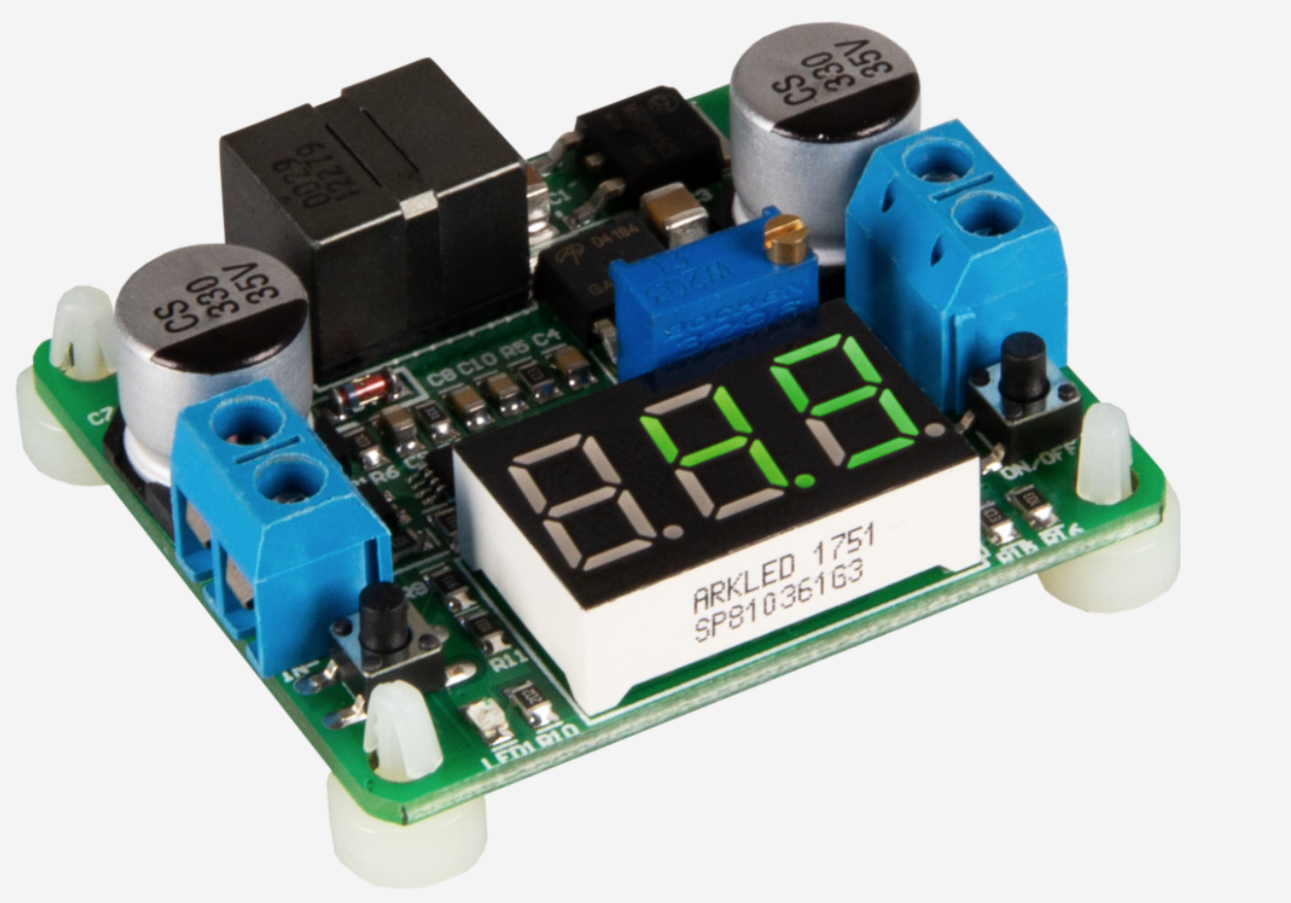



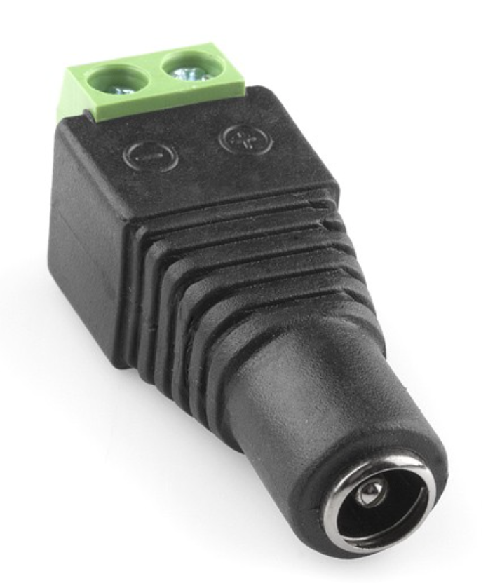

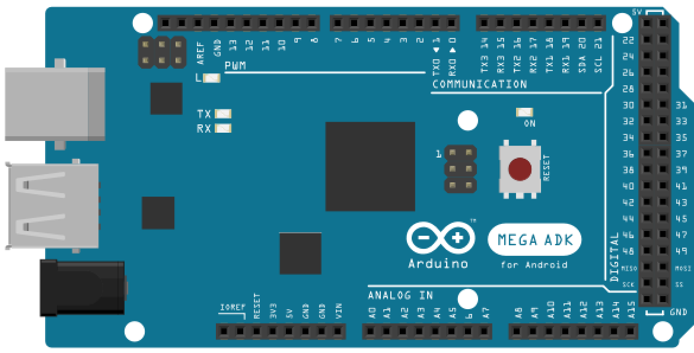
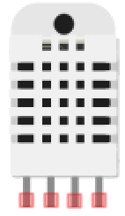
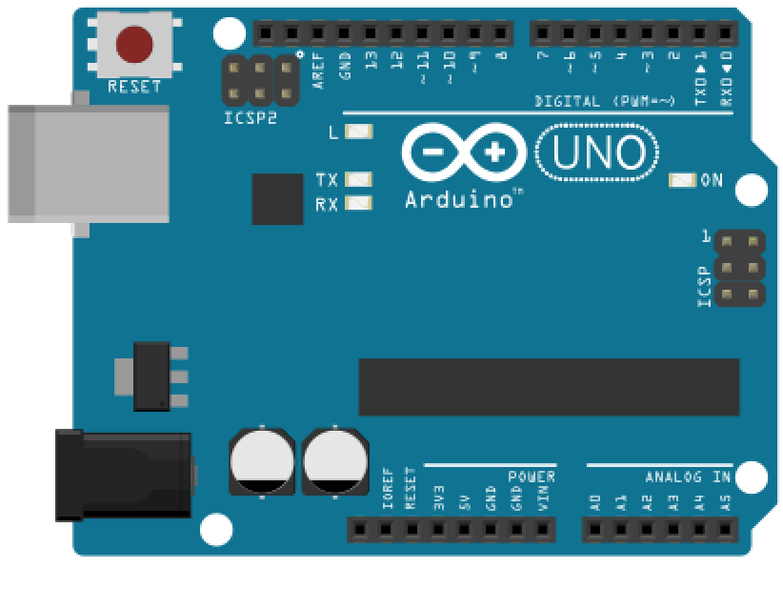
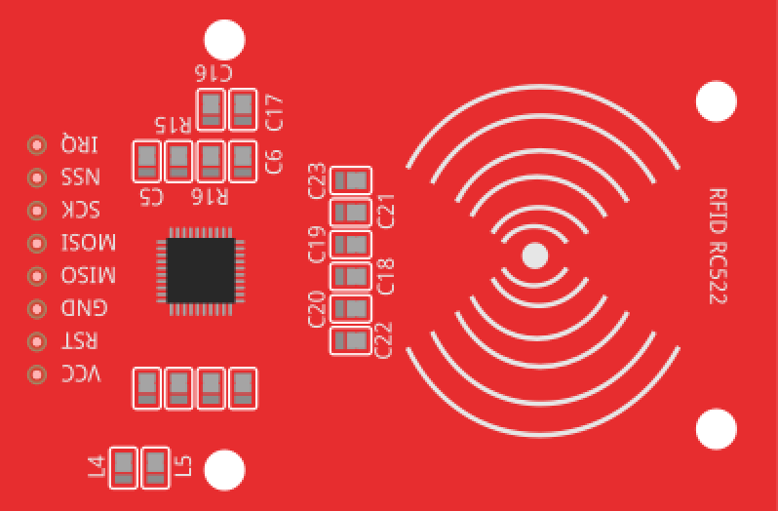



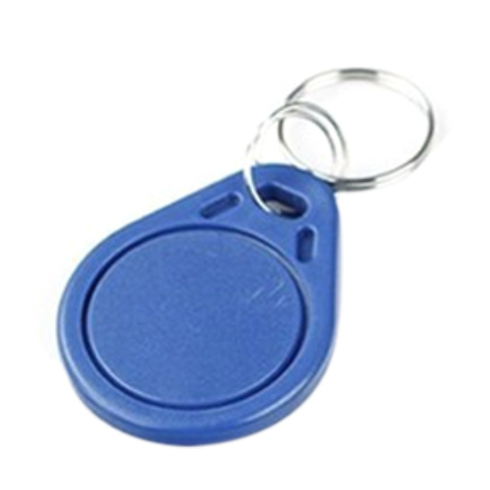

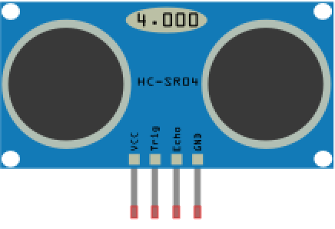
ROOM 2
ROOM 3
ROOM 1
GARAGE
ROOM 4
ROOM 5

Slide 2


Arduino Due
Ultrasonic sensor
Arduino UNO
IR sensor
RFID reader
RFID key to access Garage
Temperature sensor
RFID card to access main entrance.
Servo motor
Buzzer
Voltage Regulator
Barrel jack adapter

